Slide 1
Three Tier Home Security System Using GSM Technology
STUDENTS: PROJECT GUIDE:
AKSHAI.K.P – 3114106104005 MRS.B.YASOTHA
DHARANENDIRAN.C – 3114106104020 AP/CSE
MANOJ.S.H- 3114106104053

Slide 2
ABSTRACT:
Security and automation is a prime concern in our day-to-day life. Home security system is needed for convenience and safety. This system invented to keep home safe from intruders and hazardous situations.
We have proposed the design and implementation of a microcontroller based home security system with GSM technology.
The designed program is applied in Arduino for simulation.

Slide 3
INTRODUCTION:
Home security system is the most prominent feature for home automation. Traditional techniques of alarm based security have gained much popularity in past decades.
Nowadays, embedded system is designed to provide security due to tremendous improvement in microcontroller unit and widespread applications of GSM technology.
Consequently, the proposed system provides reliable security within reasonable cost and also removes the circuit complexity.

Slide 4
LITERATURE SURVEY:
Design and Implementation of Security Systems for Smart Home based on GSM technology - Jayashri Bangali and Arvind Shaligram in International Journal of Smart Home.
Home security is becoming necessary nowadays as the possibilities of intrusion are increasing day by day.
A traditional home security system gives the signals in terms of alarm. However, the GSM (Global System for Mobile communications) based security systems provides enhanced security.
This paper suggests two methods for home security system. The first system uses web camera. The second method sends SMS which uses GSM-GPS Module (sim548c) and Atmega644p microcontroller, sensors, relays and buzzers.

Slide 5
Jayashri Bangali and Arvind Shaligram (2013), ‘Design and Implementation of Security Systems for Smart Home based on GSM technology’
Smart Home can be also known as Automated Home or intelligent home, which indicates the automation of daily tasks with electrical appliances used in homes.
The new and emerging concept of smart homes offers a comfortable, convenient, and safe environment for occupants.
However, a smart home security system offers many more benefits. This paper mainly focuses on the security of a home when the user is away from the place.
The first security system uses a web camera, installed in house premises, which is operated by software installed on the PC and it uses Internet for communication.

Slide 6
EXISTING SYSTEM ISSUES:
Most of the existing systems are not user friendly and are expensive too.
False alarms are an extremely common problem of home security cameras. It is annoying to constantly receive alarms just because trees move in the wind or birds fly past your window.
These security system needs proper installation and maintenance is necessary to keep the system functioning properly. (it should be done with their respective service engineers).

Slide 7
PROPOSED SYSTEM:
It consists of three phases (MAGNETIC DOOR/WINDOW SENSOR, MOTION TRACKING, LPG SENSOR). This enhance the security and also accuracy rate. The alarm will be triggered only on the basis of appropriate constraints in its context.
Since it consists of magnetic sensors, accuracy is improved, whereas traditional IR sensors may trigger false alarms based on naive intrusions.
The proposed system can be easily accessible via mobile application (with/without INTERNET), with the live streaming of Motion Tracking Camera facilities.
The proposed system is also power efficient.

Slide 8
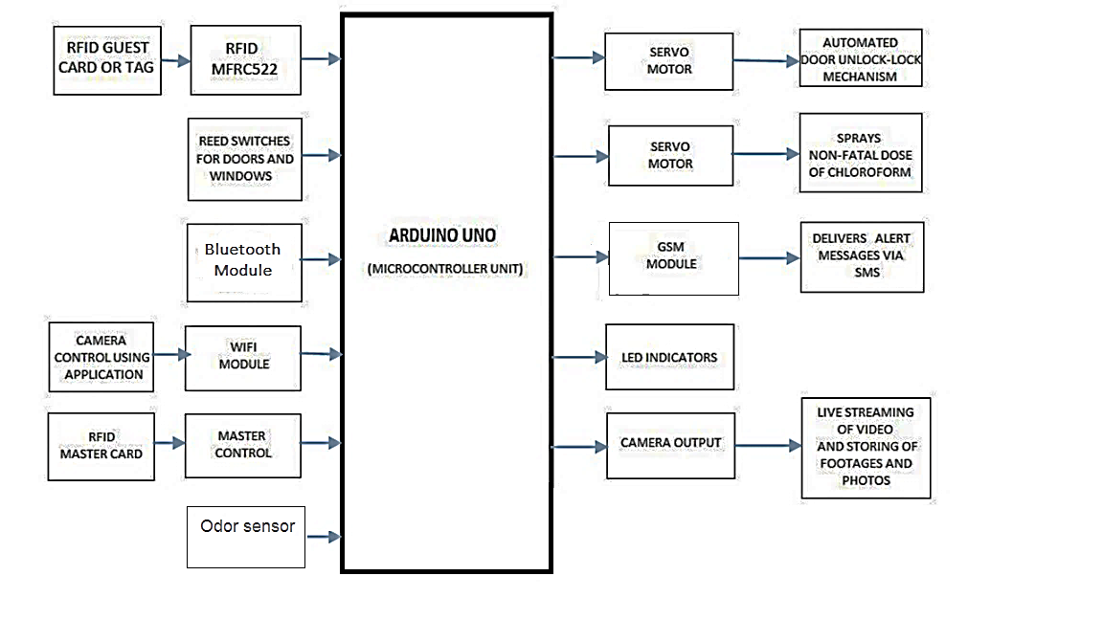
ARCHITECTURE DIAGRAM:

Slide 9
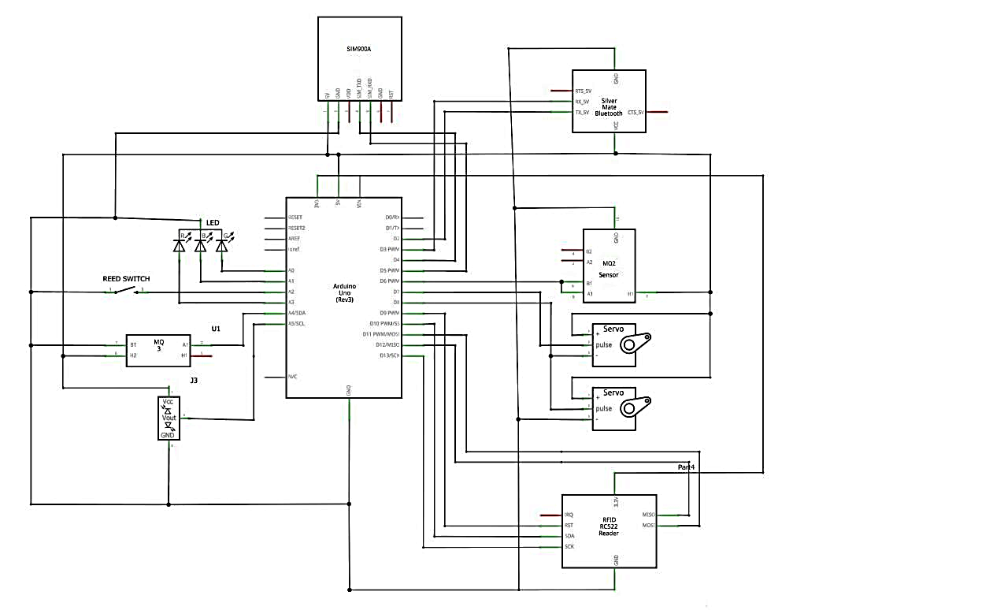
CIRCUIT DIAGRAM

Slide 10
MODULES:
RFID
SERVO MOTORS
IR CAMERA
GAS SENSOR
MQ 3

Slide 11
RFID & SERVO MOTORS:
RFID module authenticates guests and administrators.
RFID tags serves as a key to authenticate the administrator and guests.
Servo motors are used to drive automatic door lock and spray cans.

Slide 12
GSM MOBILE AND IR CAMERA:
GSM mobile sends various alert messages to the user.
IR Camera is used for surveillance purpose.
IR Camera can record video even in the absence of light.
It can be used for recording and live streaming of videos and to take snapshots.

Slide 13
MQ3 AND GAS SENSOR:
Gas sensors measures the temperature and humidity of its context.
Gas sensors are also used to detect LPG leakage in the house.
MQ3 is used to measure and validate the human odor value.

Slide 14
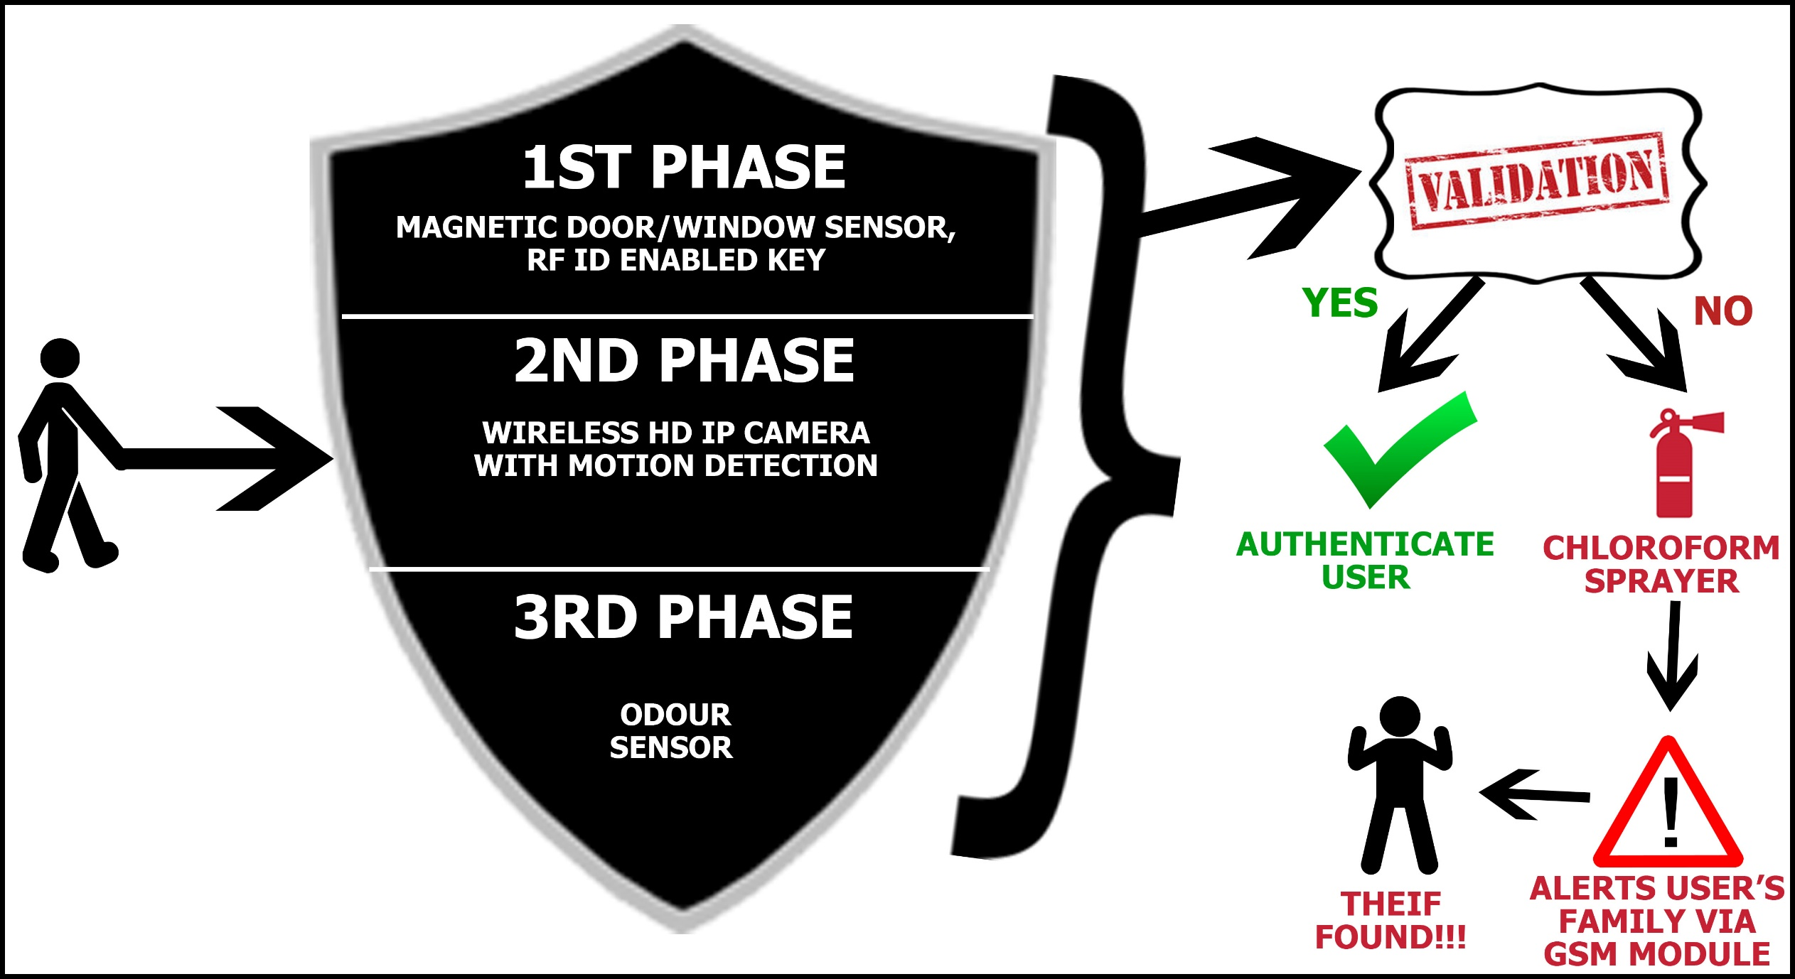
OVERVIEW OF THE PROJECT

Slide 15
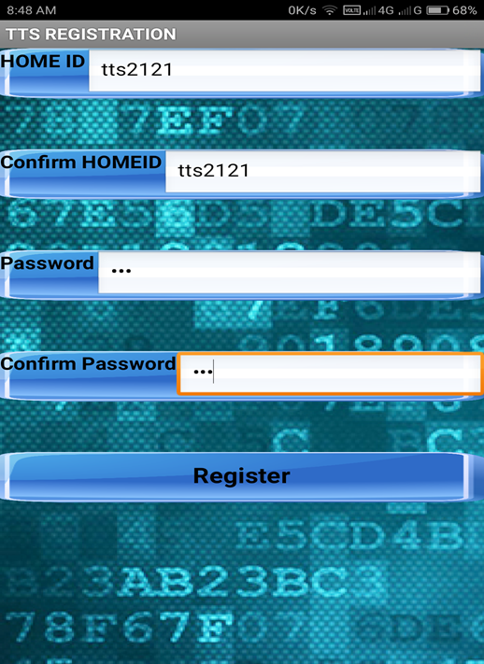
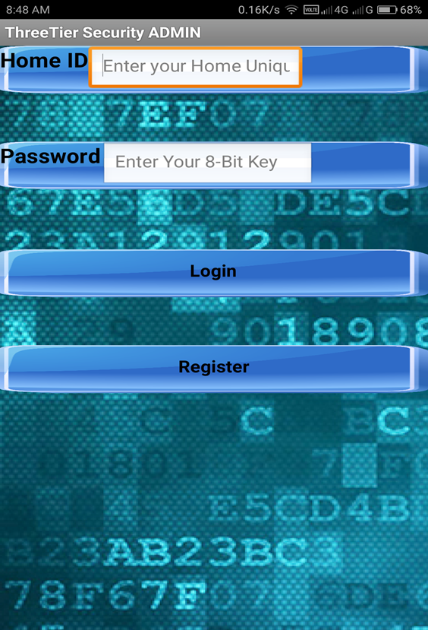
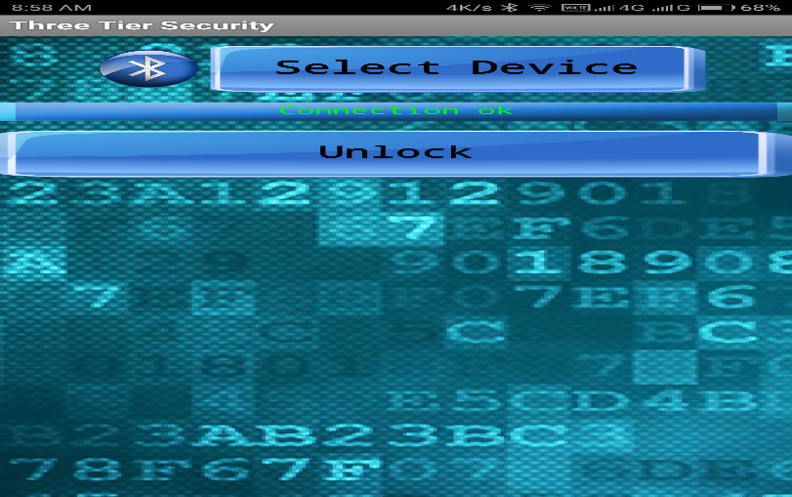
SCREENSHOTS
Registration
The initial registration procedure is shown.
2. Login
The login page is displayed. This allows initial login.
3. Bluetooth Pairing
This allows a list of devices which pairs with the Bluetooth module.

Slide 16
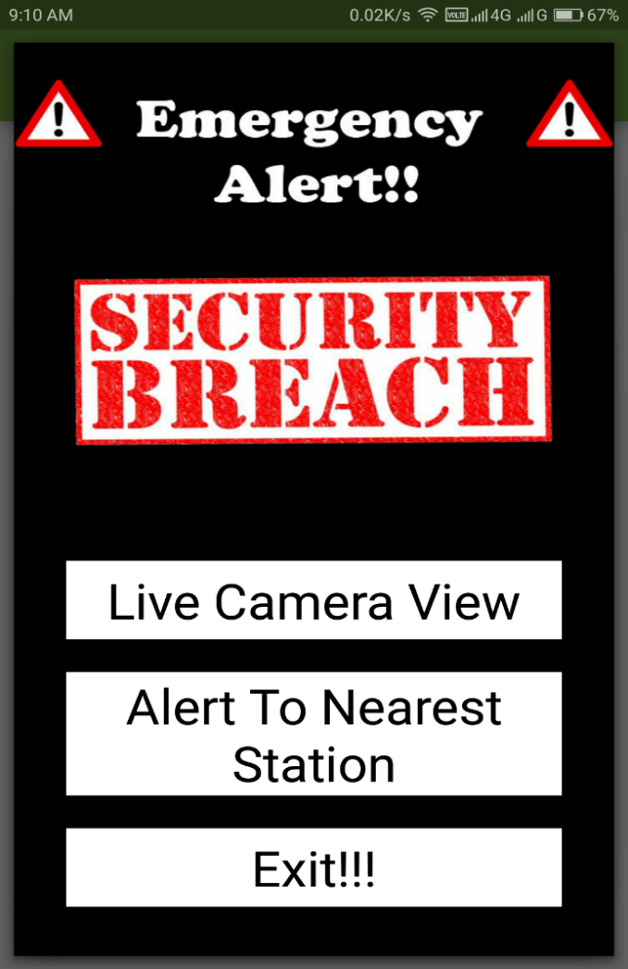
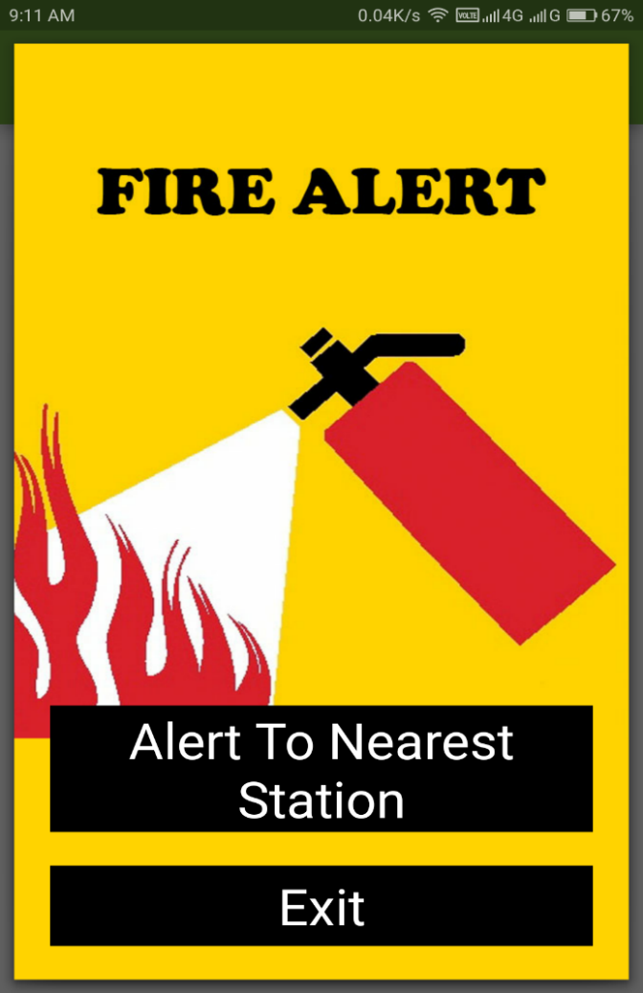
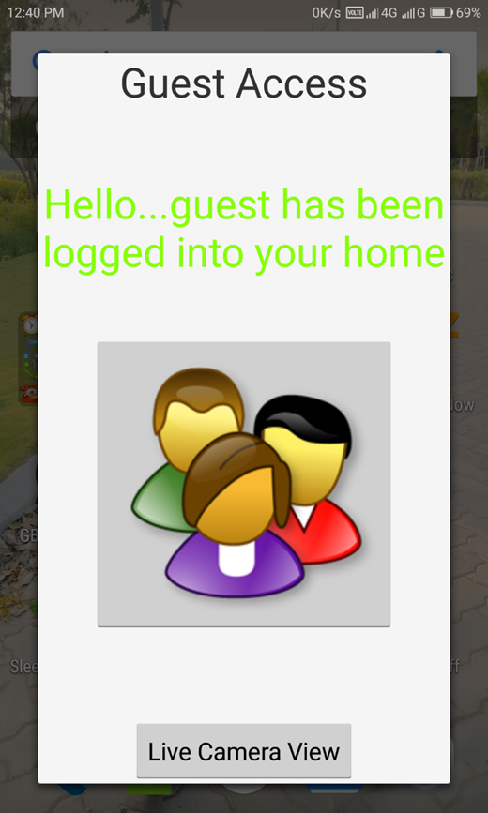
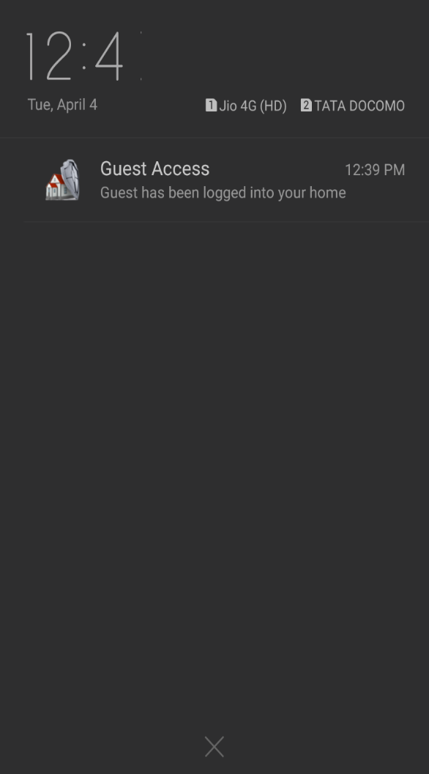
4. ALERT MESSAGES
The initial registration procedure is shown.
5. Guest User Login
This shows what happens when a guest logins and the user receiver’s notification message.

Slide 17
FUTURE ENHACEMENT
Finger vein reader
RFID based key
Baby sitter monitoring
Automated WIFI door lock
Movement based door lock

Slide 18
SUMMARY:
This proposed system presents design and implementation of a smart home security system based on microcontroller along with GSM for user friendly application. The system is intelligent enough to monitor the secure environment.
In addition, the user is informed about the security breach through GSM network that provides a special opportunity whenever the user stays at far away from home.
However, Android application is the most stunning feature in order to control the system through a wireless device.
Moreover, the system provides the reliable operation within reasonable cost and removes the system complexity.
In this work, traditional burglar alarm mode, LED lights and are the promising features used to ensure reliability. The whole system is implemented on a practical home security system which requires considerable effort to install it.

Slide 19
CONCLUSION:
In this project, we propose a dynamic proposed system presents design and implementation of a smart home security system based on microcontroller along with GSM for user-friendly application. The system is intelligent enough to monitor the secure environment. In addition, the user is informed about the security breach through GSM network that provides a special opportunity whenever the user stays at far away from home. However, Android application is the most stunning feature in order to control the system through a wireless device. Moreover, the system provides the reliable operation within reasonable cost and removes the system complexity. In this work, traditional burglar alarm mode, LED lights and are the promising features used to ensure reliability. The whole system is implemented on a practical home security system, which requires considerable effort to install it. Consequently, the system is also applicable for commercial purposes due to versatile ways of security and controllability.

Slide 20
REFERENCES:
Abhishek S. Parab (2015), ‘Implementation of Home Security System using GSM module and Microcontroller’, International Journal of Computer Science and Information Technologies.
Anandan R, Karthik B, Kiran Kumar Dr.T.V.U (2015), ‘Wireless Home And Industrial Automation Security System Using Gsm’.
Chintaiah N, Rajasekhar K, Dhanraj V (2011), ‘Automated Advanced Industrial and Home Security Using GSM and FPGA’, International Journal of Computer Science and Information Technologies.
Jayashri Bangali and Arvind Shaligram (2013), ‘Design and Implementation of Security Systems for Smart Home based on GSM technology’, International Journal of Smart Home
Raqibull Hasan, Mohammad Monirujjaman Khan, Asaduzzaman Ashek, Israt Jahan Rumpa (2015), ‘Microcontroller Based Home Security System with GSM Technology’, Open Journal of Safety Science and Technology.

Slide 21

Thank you!

Slide 22

Questions?

